Slide 1
Fantasy hurling
MICHAEL JAMES
DAVID KELLY
MARTIN ZUBAR

Slide 2
WHAT IS IT?
A fantasy hurling game
Social media aspects
Real time score updates
Real time news updates

Slide 3
Technical details
Front end of a website
Back end of Java
SQL database

Slide 4
The WEBSITE
JavaScript & JQuery
HTML & CSS
PHP

Slide 5
WHAT was DONE?
Wireframe & design of site
All web pages complete
RSS feed for news
Player analysis

Slide 6
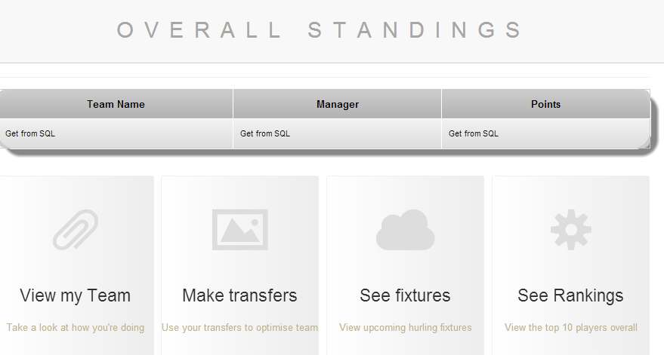
.
Standings page
Score will be retrieved using java from sql database

Slide 7
FINDING THE FACTS
Thorough research into player statistics
HURLINGSTATS.COM
Very important to the integrity of the site

Slide 8
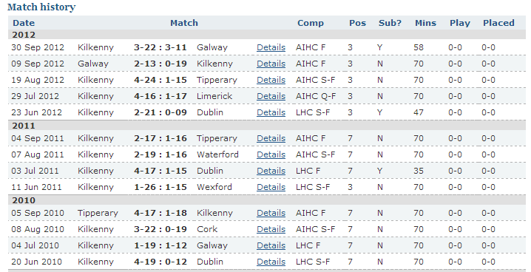
Hurlingstats.com
.

Slide 9
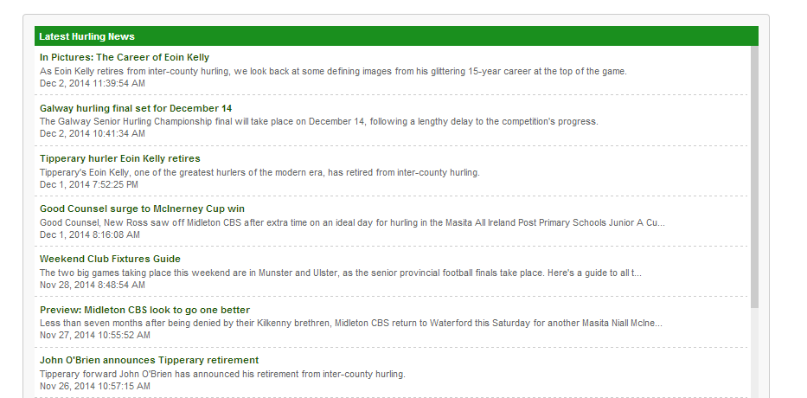
RSS FEED
.

Slide 10
What IS needed?
Login
Standings link to java
Team changer & viewer
Social media aspect
Connection of front end to back

Slide 11
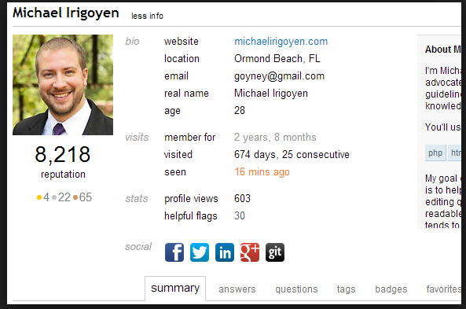
SOCIAL MEDIA
.

Slide 12
conclusion
On course to meet deadline
End product should be of high standard and modular
High possibility of attracting players
Advertising!

Slide 13
Questions??
Fantasy Hurling
By Michael James , Martin Zubar & David Kelly

